Slide 1

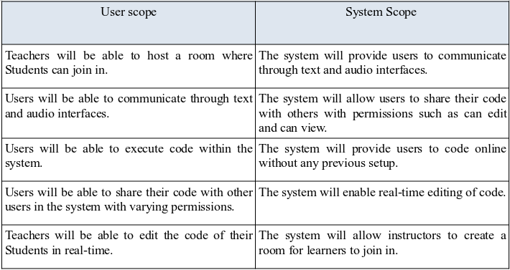
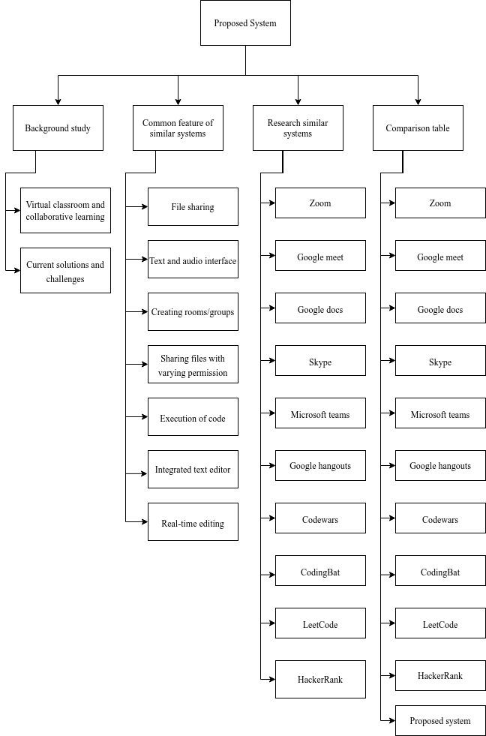
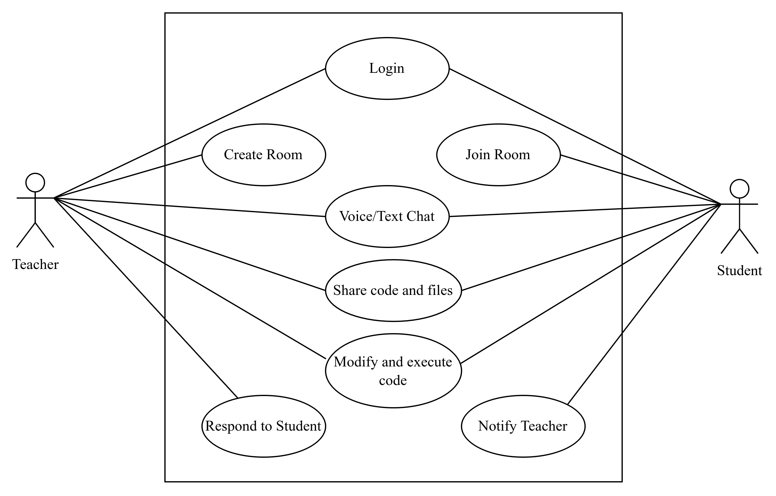
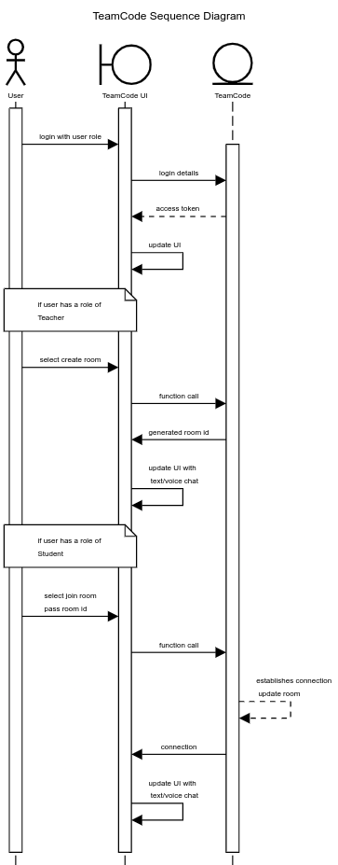
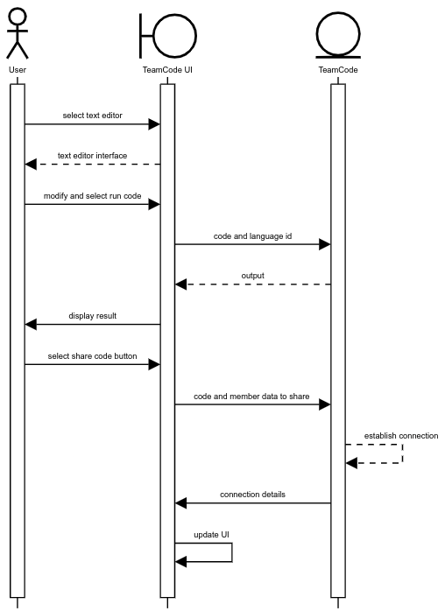
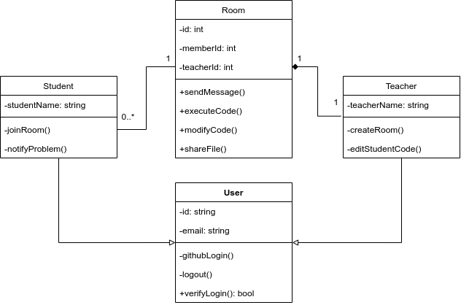
An Interactive Web Application to Learn Coding Online with Real-Time Data Exchange
Background Studies and Outline
Introduction TeamCode will a web application that aims to provide an interactive model to existing online learning methods for programming. With this application, the instructor will be able to have real-time communication with learners and vice-versa to solve any problems encountered through a flag system. Online Learning, when used for practical subjects like programming, produces results inferior to learning the subject in full-time classes thereby failing to fully replicate the classroom interaction. The project will implement real-time code editing and communication through text and audio interfaces to replicate classroom interaction. | Problem Statement Existing applications used to learn to code online provide fewer features for real-time editing of code. Existing applications have fewer models for users to pass on notifications to their instructors by highlighting the point at which they encounter anomalies in their code. Existing applications require users to install and configure necessary software before they can learn to code online. Fewer systems have diverse accessibility control options such as view only and can edit. | Objectives To create a real-time application using WebRTC and Websockets. To provide the feature of real-time editing that an instructor can access to solve a learner's problem. To make use of flags with the help of which learners can notify any problem. To provide a platform for learning to code without having the need to set up and configure programming environments. To create an interface to write and modify code using Monaco editor. To execute the written code with Judge0 API (Application Programming Interface) and display the output. To create an audio channel of communication between instructors and learners. To include diverse control options like can edit and can view within the system.
 |  | Scope of Work
Literature Review
Methodology
Literature Review Map/ Summary Table | Functional Model Structure Model | Behavioural Model
Expected Results and Contributions
Expected Results Users will be able to communicate through voice/text chat. Users will be able to modify and execute code. Instructor will be able to use the feature of real-time editing to solve a learner's problem. Users will be able to notify any problems during execution of code with Teacher. | Conclusion There exists a gap between distance learners and face-to-face learners especially in terms of programming subjects and research suggests that interaction plays a major role in the success of distance learning. Synchronous meeting apps help to provide collaboration and interactive elements to online learning while online judge apps provide a platform for users to gain technical knowledge. Taking elements from both these applications TeamCode will provide real-time interaction using WebSockets and a communication channels with an audio interface through WebRTC.
 | References Deepika, V., Soundariya, K., Karthikeyan, K., & Kalaiselvan, G. (2021). ‘Learning from home’: Role of e-learning methodologies and tools during novel coronavirus pandemic outbreak. Postgraduate Medical Journal, 97(1151), 590. https://doi.org/10.1136/postgradmedj-2020-137989 Driscoll, A., Jicha, K., Hunt, A. N., Tichavsky, L., & Thompson, G. (2012). Can Online Courses Deliver In-class Results?: A Comparison of Student Performance and Satisfaction in an Online versus a Face-to-face Introductory Sociology Course. Teaching Sociology, 40(4), 312–331. https://doi.org/10.1177/0092055X12446624 Fojtik, R. (2017). Issues in Distance Learning of Programming. New Trends and Issues Proceedings on Humanities and Social Sciences, 3, 48–54. https://doi.org/10.18844/gjhss.v3i3.1522 Laal, M. (2013). Collaborative Learning; Elements. Procedia - Social and Behavioral Sciences, 83, 814–818. https://doi.org/10.1016/j.sbspro.2013.06.153 Laal, M., & Laal, M. (2012). Collaborative learning: What is it? Procedia - Social and Behavioral Sciences, 31, 491–495. https://doi.org/10.1016/j.sbspro.2011.12.092 Mihai, A. (2014). The Virtual Classroom: Teaching European Studies Through Webinars. European Political Science, 13(1), 4–11. https://doi.org/10.1057/eps.2013.31 Nokes-Malach, T. J., Richey, J. E., & Gadgil, S. (2015). When Is It Better to Learn Together? Insights from Research on Collaborative Learning. Educational Psychology Review, 27(4), 645–656. https://doi.org/10.1007/s10648-015-9312-8 Puranik, D. G., Feiock, D. C., & Hill, J. H. (2013). Real-Time Monitoring using AJAX and WebSockets. 2013 20th IEEE International Conference and Workshops on Engineering of Computer Based Systems (ECBS). https://doi.org/10.1109/ECBS.2013.10 Pyhältö, K., Stubb, J., & Lonka, K. (2009). Developing scholarly communities as learning environments for doctoral students. International Journal for Academic Development, 14(3), 221–232. https://doi.org/10.1080/13601440903106551 Rehman, S. ur, & Khan, M. U. (2016). Security and Reliability Requirements for a Virtual Classroom. Procedia Computer Science, 94, 447–452. https://doi.org/10.1016/j.procs.2016.08.069 Zinovieva, I. S., Artemchuk, V. O., Iatsyshyn, A. V., Popov, O. O., Kovach, V. O., Iatsyshyn, A. V., Romanenko, Y. O., & Radchenko, O. V. (2021). The use of online coding platforms as additional distance tools in programming education. Journal of Physics: Conference Series, 1840(1), 16. https://doi.org/10.1088/1742-6596/1840/1/012029
Name: ARJAN GAHATRAJ SUNAR
ID: 041902900012
Program Code: CSC 3810
FEB 2022 – FYP POSTER IUKL

